Slide 1



BMS
Institute of Technology and Management
Module – 4
DERENGMENTS
18CS36
By,
Dr. Pushpa S. K
Professor
Dept. of Information Science & Engg.
BMS Institute of Technology & Mgmt. Bengaluru.
Department of Information Science & Engineering

Slide 2
What is Derangement?
Derangement can be simply defined as a permutational arrangement with no fixed points. In other words, derangement can be explained as the permutation of the elements of a certain set in a way that no element of that set appears in their original positions.

Slide 3
Derangement
Seats
1 2 3 4 5
2 1 5 3 4
D1- Derangements
2 5 1 3 4
D2- Derangements
3 4 1 5 2
D3- Derangements
Problem1 : How many derangements possible for 5 numbers?

Slide 4
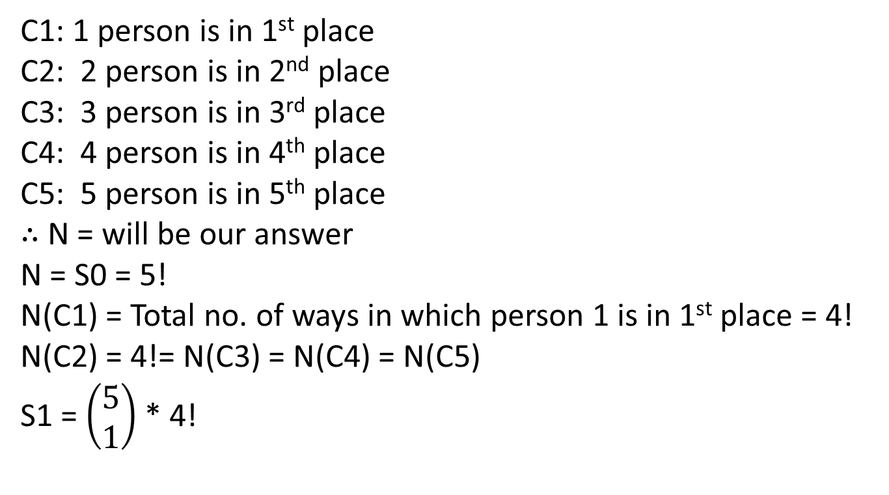
C1: 1 person is in 1st place
C2: 2 person is in 2nd place
C3: 3 person is in 3rd place
C4: 4 person is in 4th place
C5: 5 person is in 5th place
$∴$ N = will be our answer
N = S0 = 5!
N(C1) = Total no. of ways in which person 1 is in 1st place = 4!
N(C2) = 4!= N(C3) = N(C4) = N(C5)
S1 = $\left(\begin{aligned}5 \\ 1\end{aligned}\right)$ * 4!

Slide 5
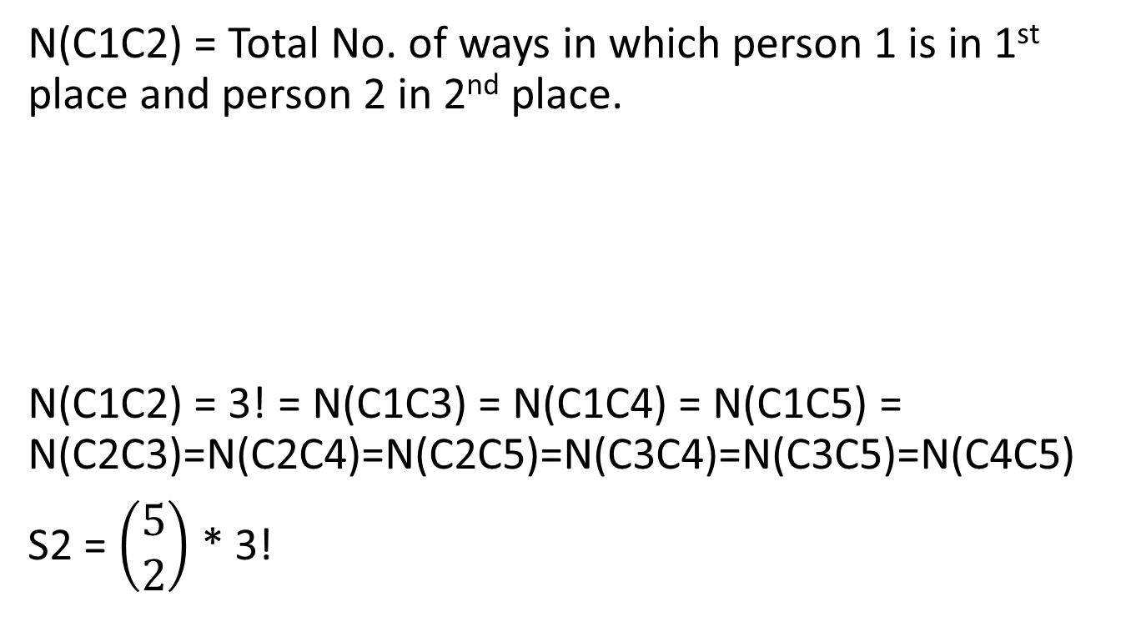
N(C1C2) = Total No. of ways in which person 1 is in 1st place and person 2 in 2nd place.
N(C1C2) = 3! = N(C1C3) = N(C1C4) = N(C1C5) = N(C2C3)=N(C2C4)=N(C2C5)=N(C3C4)=N(C3C5)=N(C4C5)
S2 = $\left(\begin{aligned}5 \\ 2\end{aligned}\right)$ * 3!
1 2 any place

Slide 6
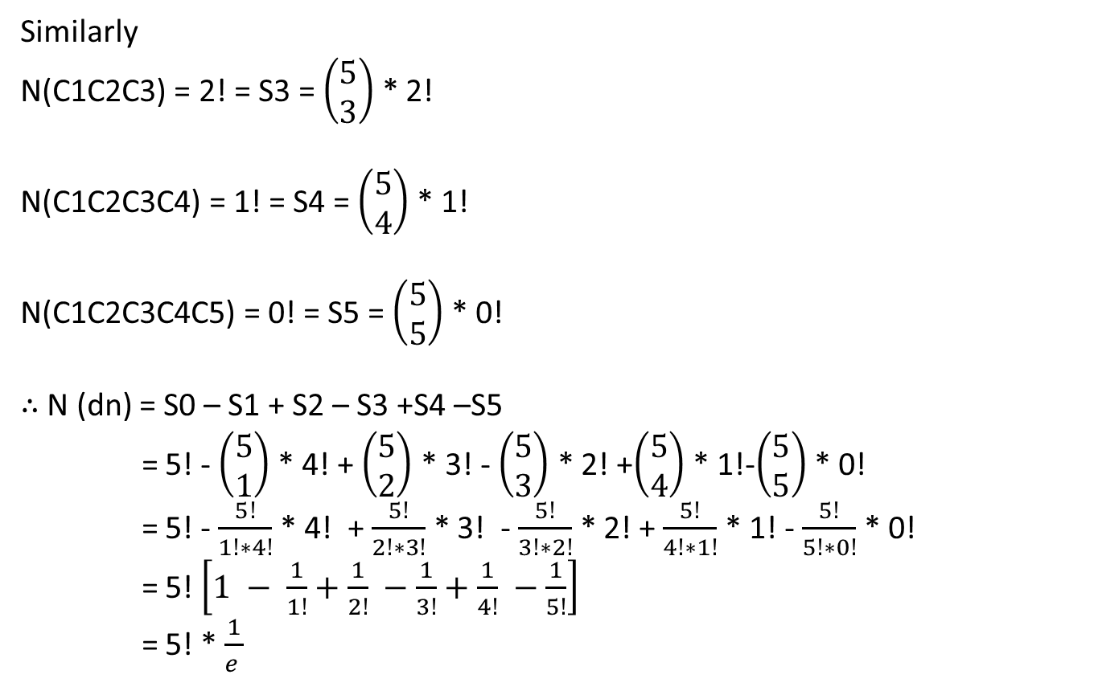
Similarly
N(C1C2C3) = 2! = S3 = $\left(\begin{aligned}5 \\ 3\end{aligned}\right)$ * 2!
N(C1C2C3C4) = 1! = S4 = $\left(\begin{aligned}5 \\ 4\end{aligned}\right)$ * 1!
N(C1C2C3C4C5) = 0! = S5 = $\left(\begin{aligned}5 \\ 5\end{aligned}\right)$ * 0!
$∴$ N (dn) = S0 – S1 + S2 – S3 +S4 –S5
= 5! - $\left(\begin{aligned}5 \\ 1\end{aligned}\right)$ * 4! + $\left(\begin{aligned}5 \\ 2\end{aligned}\right)$ * 3! - $\left(\begin{aligned}5 \\ 3\end{aligned}\right)$ * 2! +$\left(\begin{aligned}5 \\ 4\end{aligned}\right)$ * 1!-$\left(\begin{aligned}5 \\ 5\end{aligned}\right)$ * 0!
= 5! - $\frac{5!}{1!∗4!}$ * 4! + $\frac{5!}{2!∗3!}$ * 3! - $\frac{5!}{3!∗2!}$ * 2! + $\frac{5!}{4!∗1!}$ * 1! - $\frac{5!}{5!∗0!}$ * 0!
= 5! $\left[1 − \frac{1}{1!}+\frac{1}{2!} −\frac{1}{3!}+\frac{1}{4!} −\frac{1}{5!}\right]$
= 5! * $\frac{1}{e }$

Slide 7
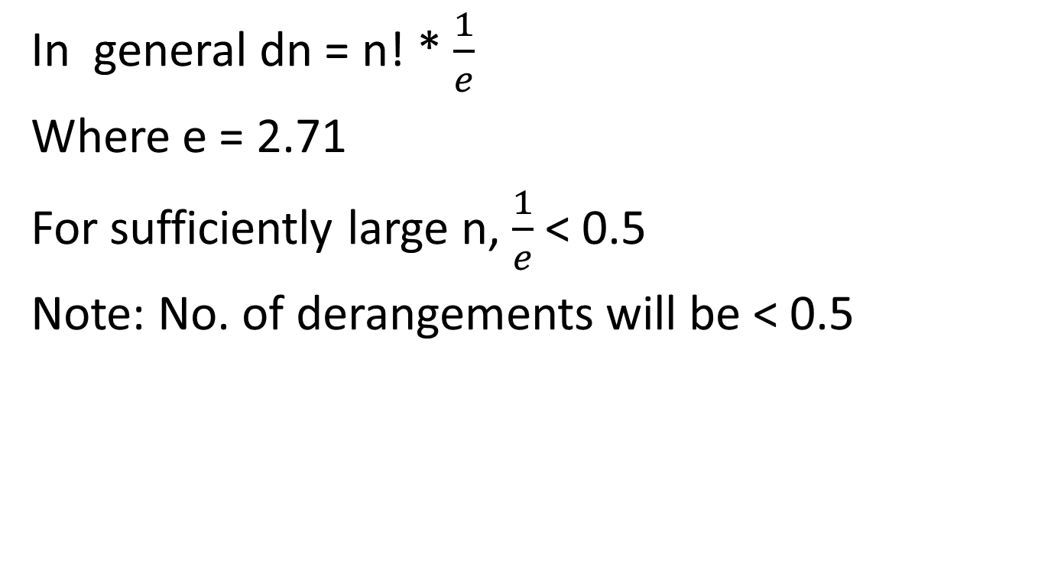
In general dn = n! * $\frac{1}{e}$
Where e = 2.71
For sufficiently large n, $\frac{1}{e}$< 0.5
Note: No. of derangements will be < 0.5

Slide 8
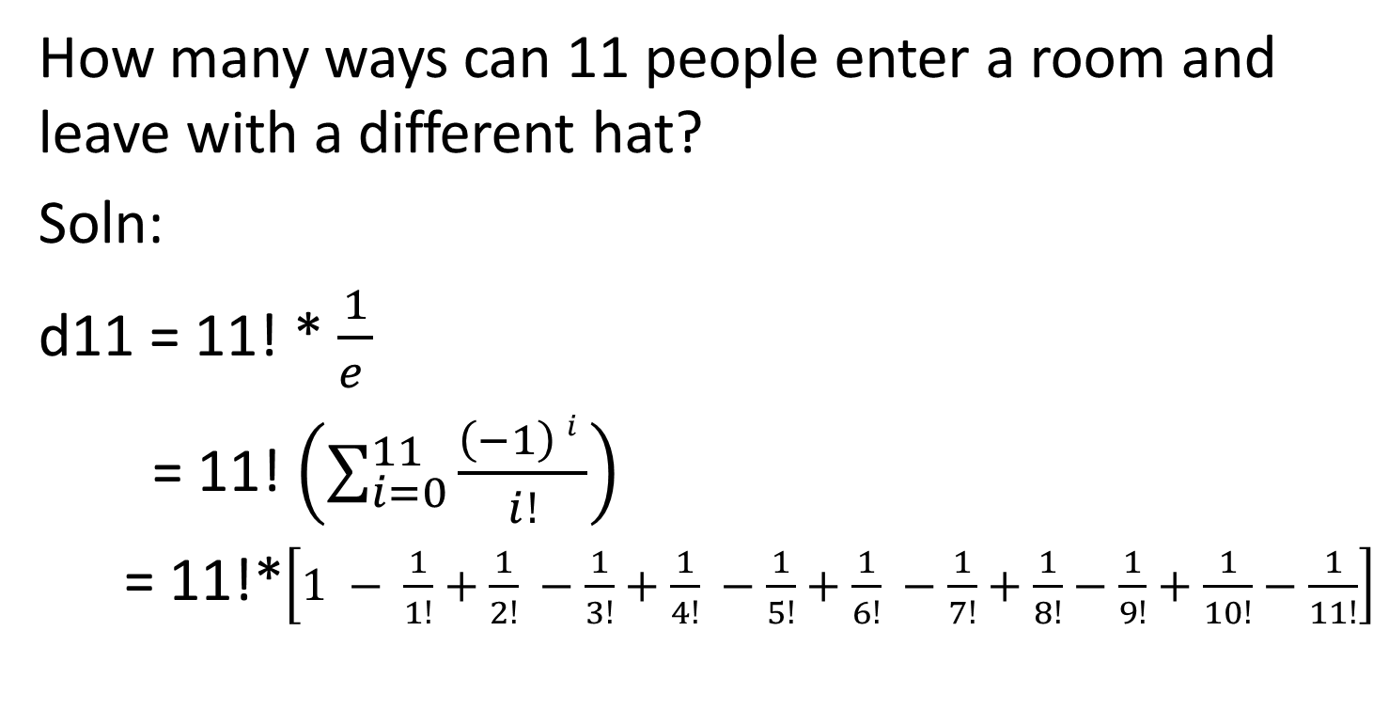
Problem2
How many ways can 11 people enter a room and leave with a different hat?
Soln:
d11 = 11! * $\frac{1}{e }$
= 11! $\left(\sum_{i=0}^{11}{\frac{\left(−1\right) i }{i!}}\right)$
= 11!*$\left[1 − \frac{1}{1!}+\frac{1}{2!} −\frac{1}{3!}+\frac{1}{4!} −\frac{1}{5!}+\frac{1}{6!} −\frac{1}{7!}+\frac{1}{8!}−\frac{1}{9!}+\frac{1}{10!}−\frac{1}{11!}\right]$

Slide 9
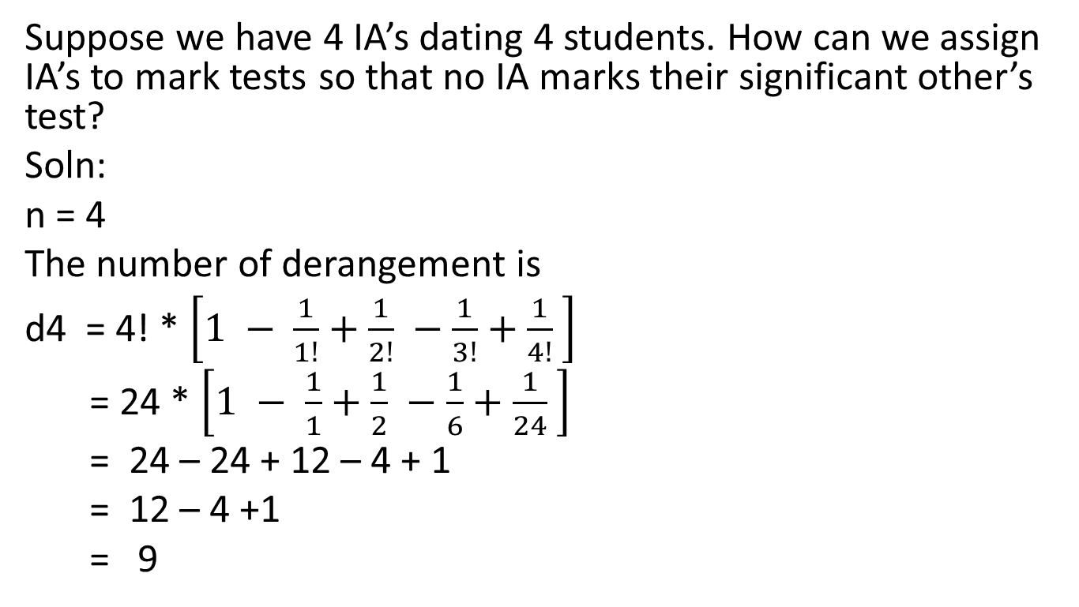
Problem3
Suppose we have 4 IA’s dating 4 students. How can we assign IA’s to mark tests so that no IA marks their significant other’s test?
Soln:
n = 4
The number of derangement is
d4 = 4! * $\left[1 − \frac{1}{1!}+\frac{1}{2!} −\frac{1}{3!}+\frac{1}{4!} \right]$
= 24 * $\left[1 − \frac{1}{1}+\frac{1}{2} −\frac{1}{6}+\frac{1}{24} \right]$
= 24 – 24 + 12 – 4 + 1
= 12 – 4 +1
= 9

Slide 10
Problem4
Mrs. X teaches geometry and then biology to a class of 12 advanced students in a classroom that only has 12 desks.
How many ways can she assign the students to the desks, so that no student is seated in the same desk for both classes?
How many ways can she assign the students to the desks, so that exactly six students occupy the same desk for both classes?

Slide 11
At first teacher assigns desks to students in 12! Ways. Each such distribution fixes the position of the 12 students. The redistribution of the desk such that no student will get the same desk again is a derangement of these positions.
This can be achieved in (n!)*dn ways.

Slide 12
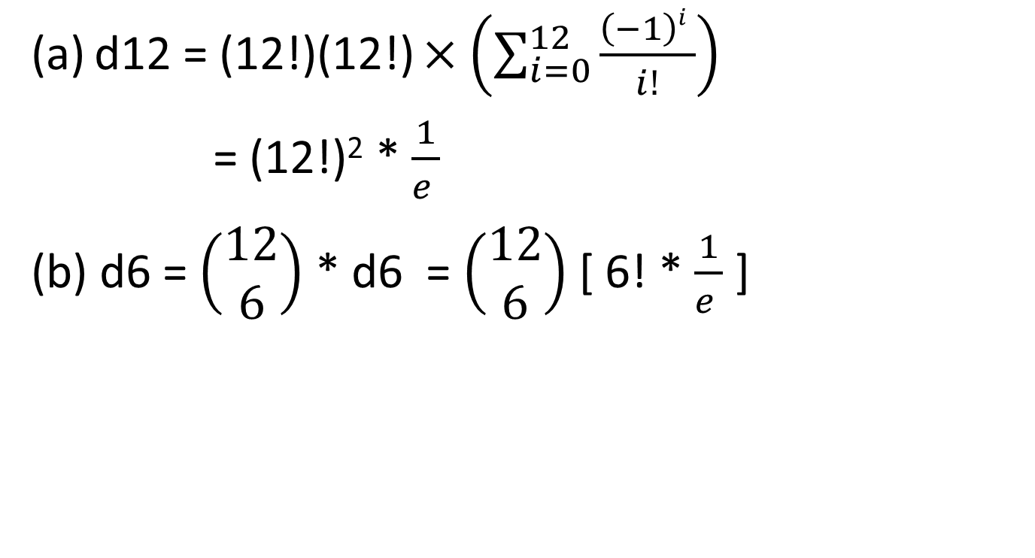
d12 = (12!)(12!)$×\left(\sum_{i=0}^{12}{\frac{\left(−1\right)i }{i!}}\right)$
= (12!)² * $\frac{1}{e }$
(b) d6 = $\left(\begin{aligned}12 \\ 6\end{aligned}\right)$ * d6 = $\left(\begin{aligned}12 \\ 6\end{aligned}\right)$ [ 6! * $\frac{1}{e }$ ]

Slide 13
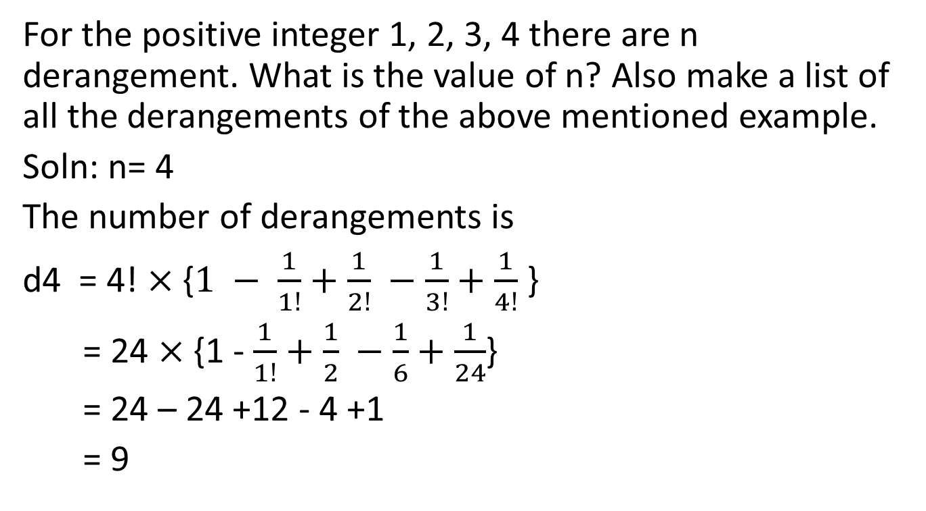
Problem5
For the positive integer 1, 2, 3, 4 there are n derangement. What is the value of n? Also make a list of all the derangements of the above mentioned example.
Soln: n= 4
The number of derangements is
d4 = 4! $×$ {$1 − \frac{1}{1!}+\frac{1}{2!} −\frac{1}{3!}+\frac{1}{4!}$ }
= 24 $×$ {1 -$\frac{1}{1!}+\frac{1}{2} −\frac{1}{6}+\frac{1}{24}$}
= 24 – 24 +12 - 4 +1
= 9

Slide 14
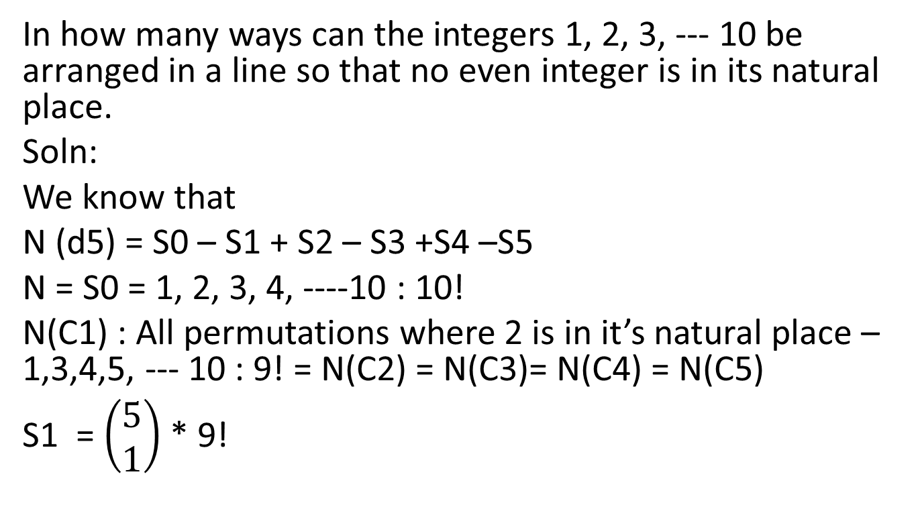
Problem6
In how many ways can the integers 1, 2, 3, --- 10 be arranged in a line so that no even integer is in its natural place.
Soln:
We know that
N (d5) = S0 – S1 + S2 – S3 +S4 –S5
N = S0 = 1, 2, 3, 4, ----10 : 10!
N(C1) : All permutations where 2 is in it’s natural place – 1,3,4,5, --- 10 : 9! = N(C2) =N(C3)= N(C4) =N(C5)
S1 = $\left(\begin{aligned}5 \\ 1\end{aligned}\right)$ * 9!

Slide 15
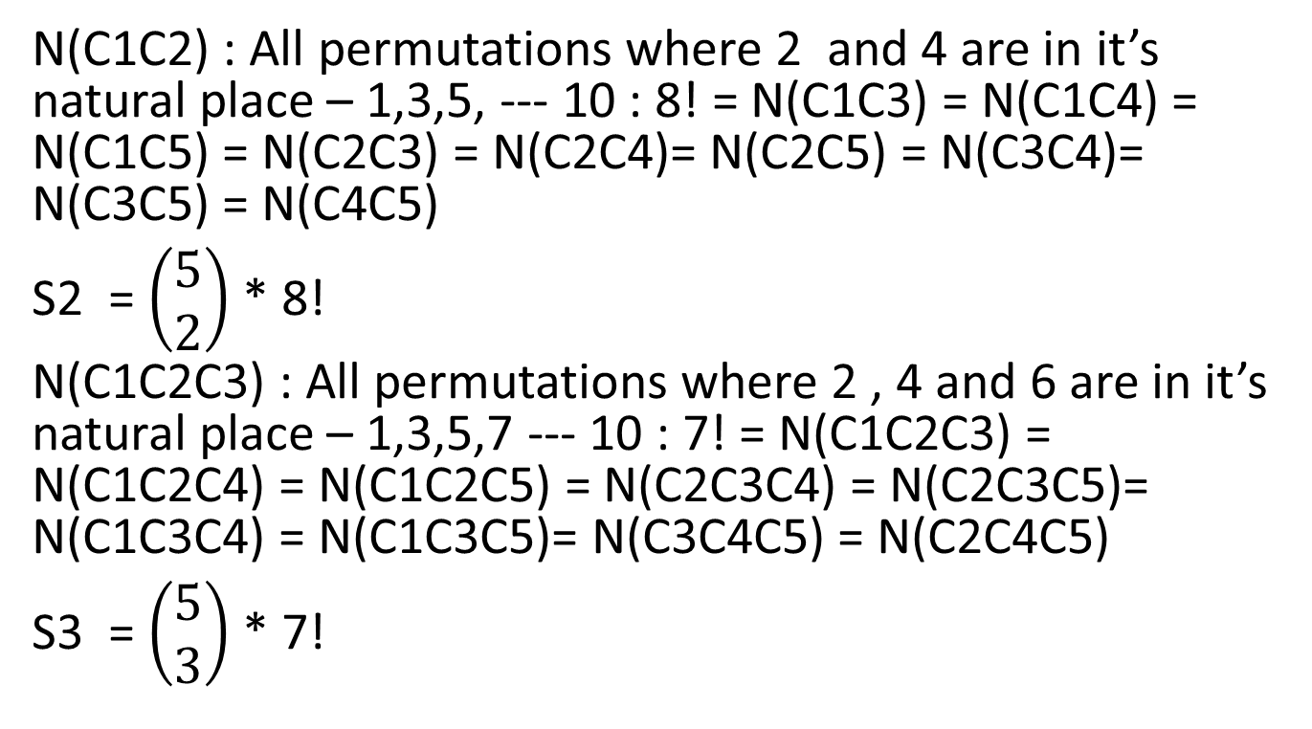
Problem6
N(C1C2) : All permutations where 2 and 4 are in it’s natural place – 1,3,5, --- 10 : 8! = N(C1C3) =N(C1C4) = N(C1C5) = N(C2C3) = N(C2C4)= N(C2C5) =N(C3C4)=N(C3C5) = N(C4C5)
S2 = $\left(\begin{aligned}5 \\ 2\end{aligned}\right)$ * 8!
N(C1C2C3) : All permutations where 2 , 4 and 6 are in it’s natural place – 1,3,5,7 --- 10 : 7! = N(C1C2C3) = N(C1C2C4) = N(C1C2C5) = N(C2C3C4) = N(C2C3C5)= N(C1C3C4) = N(C1C3C5)= N(C3C4C5) = N(C2C4C5)
S3 = $\left(\begin{aligned}5 \\ 3\end{aligned}\right)$ * 7!

Slide 16
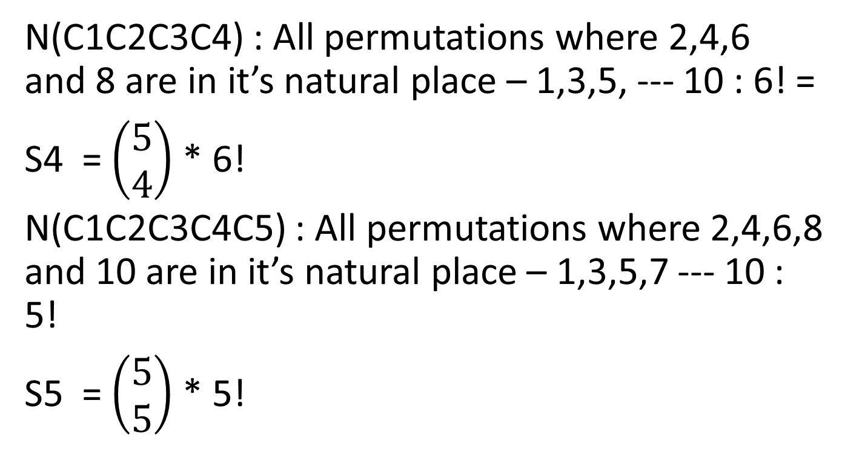
Problem6
N(C1C2C3C4) : All permutations where 2,4,6 and 8 are in it’s natural place – 1,3,5, --- 10 : 6! =
S4 = $\left(\begin{aligned}5 \\ 4\end{aligned}\right)$ * 6!
N(C1C2C3C4C5) : All permutations where 2,4,6,8 and 10 are in it’s natural place – 1,3,5,7 --- 10 : 5!
S5 = $\left(\begin{aligned}5 \\ 5\end{aligned}\right)$ * 5!

Slide 17
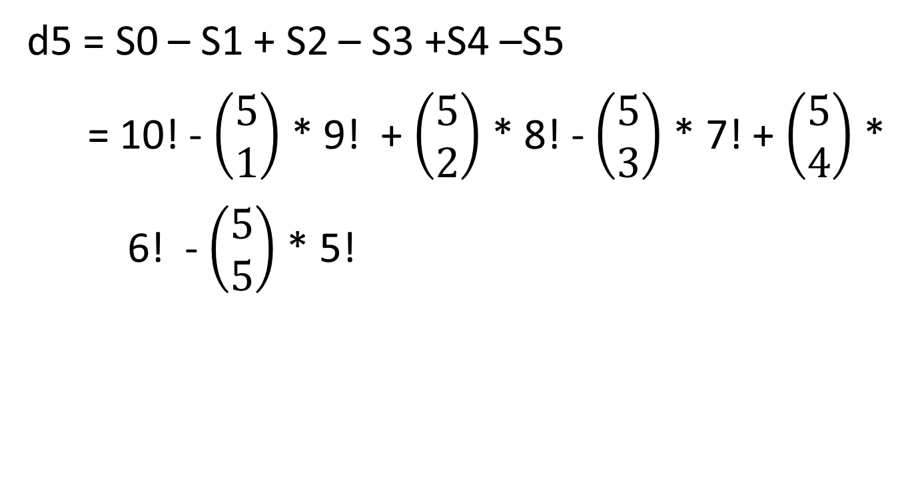
Problem6
d5 = S0 – S1 + S2 – S3 +S4 –S5
= 10! - $\left(\begin{aligned}5 \\ 1\end{aligned}\right)$ * 9! + $\left(\begin{aligned}5 \\ 2\end{aligned}\right)$ * 8! - $\left(\begin{aligned}5 \\ 3\end{aligned}\right)$ * 7! + $\left(\begin{aligned}5 \\ 4\end{aligned}\right)$ *
6! - $\left(\begin{aligned}5 \\ 5\end{aligned}\right)$ * 5!

Slide 18
Thank You

